Slide 1
NATIONAL INSTITUTE OF TECHNOLOGY SRINAGAR
Statistical Analysis and
Machine Learning-Based Prediction of Wine Quality
Physicochemical properties • statistical inference • sampling • regression
ORIGINAL DATA
CLEANED DATA
STATISTICAL FOCUS
ML TASK
1,599 rows
11 predictors + quality
1,359 unique rows
240 duplicate rows removed
Alcohol mean, CI,
hypothesis tests, sampling
Predict numerical quality
Regression problem
Research question: To what extent can the physicochemical properties of red wine explain variations in quality scores, and how accurately can machine learning models predict these scores?
NIT Srinagar | Data Analytics Project | Red Wine Quality
1 / 6

Slide 2
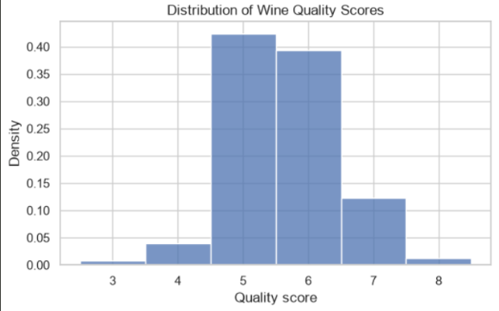
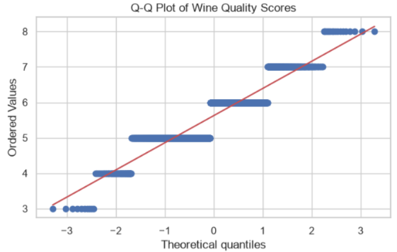
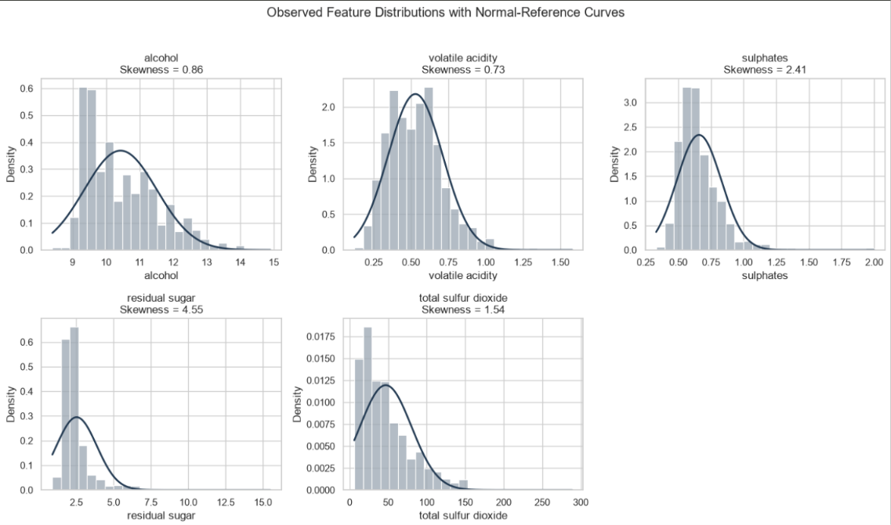
01 | DATASET AND DATA QUALITY
What does the dataset look like?
UCI Red Wine Quality • 1,599 original rows • 1,359 rows after exact-duplicate removal
DATA TYPES
ROWS
11 numerical physicochemical predictors; quality is a discrete numerical score.
1,599
original
PREPROCESSING
COLUMNS
12
No missing values. Removed 240 exact duplicate rows; duplicates were not automatically assumed to be errors.
11 features + target
INTERPRETATION
MISSING VALUES
Quality scores cluster around 5–6; rare scores are less represented. This is a discrete target distribution, not proof of normality.
0
no imputation
DUPLICATES
240
exact duplicate rows
NIT Srinagar | Data Analytics Project | Red Wine Quality
2 / 6

Slide 3
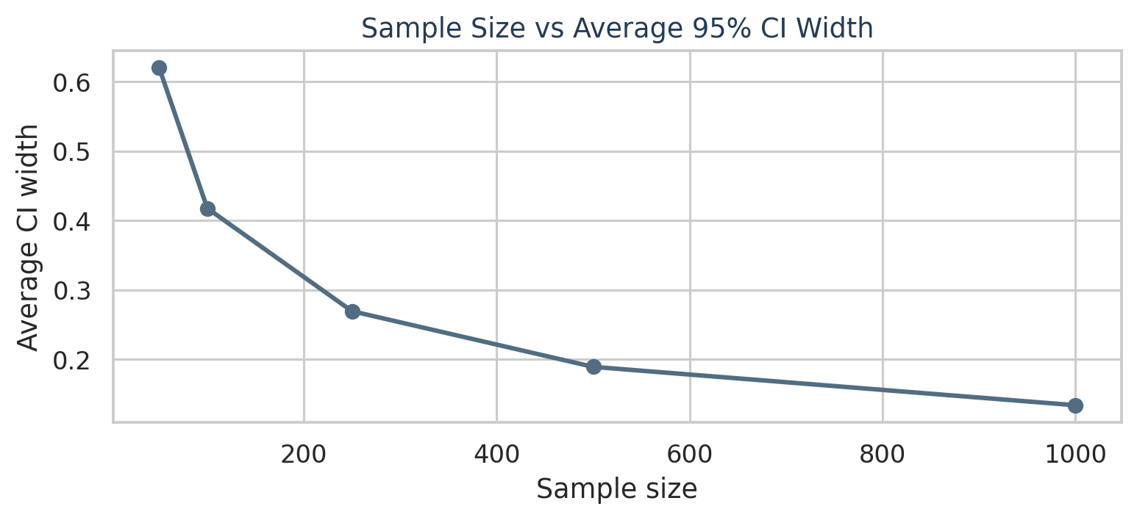
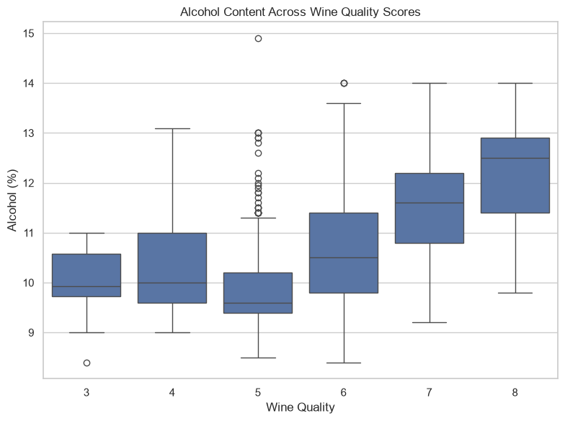
02 | STATISTICAL INFERENCE AND SAMPLING
Alcohol, hypothesis tests and sample-size effects
The notebook's observed results are shown below; statistical significance does not imply causation.
ALCOHOL MEAN
10.4323%
95% CI: 10.3747%–10.4899%
GROUP COMPARISON
Mean alcohol: quality ≤5 = 9.9208%; quality ≥6 = 10.8876%.
Welch test: p ≈ 1.80 × 10⁻⁶⁹
Decision at α = 0.05: reject H₀
SAMPLING AND CLT
Larger samples usually give smaller standard errors and narrower confidence intervals. The CLT explains how sample means are distributed, not how the original data is distributed.
CORRELATION
r = 0.4803
alcohol vs quality
Sampling method: SRS is a baseline; stratification by quality can preserve rare-score representation. For population estimates, account for stratum proportions.
3 / 6

Slide 4
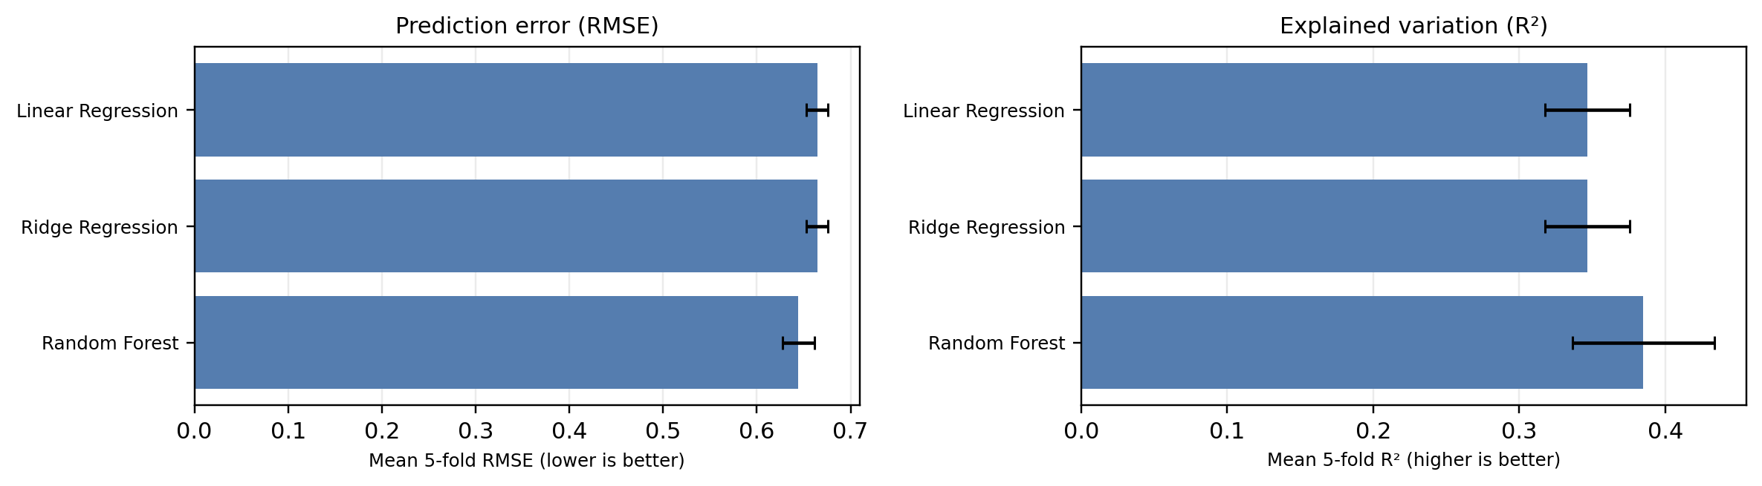
03 | MACHINE LEARNING
Three-model regression comparison
Five-fold shuffled cross-validation • same splits for all three models
Model
MAE ↓
RMSE ↓
R² ↑
Linear Regression
0.5118 ± 0.0163
0.6645 ± 0.0113
0.3465 ± 0.0291
Ridge Regression
0.5118 ± 0.0163
0.6645 ± 0.0113
0.3466 ± 0.0291
Random Forest
0.4930 ± 0.0162
0.6442 ± 0.0170
0.3850 ± 0.0488
Finding: Random Forest has the lowest mean MAE and RMSE and highest mean R² among these three models. Ridge and Linear Regression are almost identical.
NIT Srinagar | Data Analytics Project | Red Wine Quality
4 / 6

Slide 5
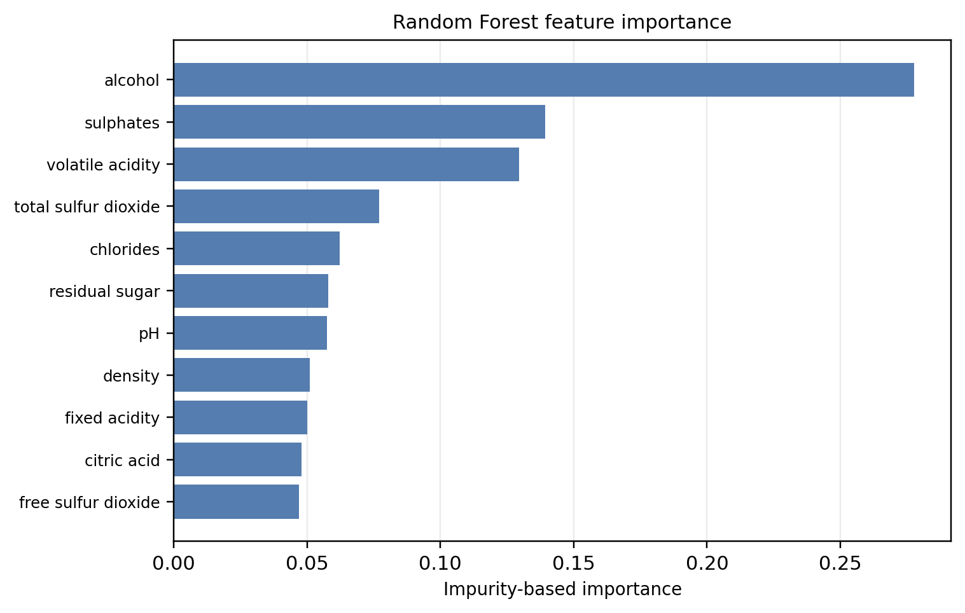
04 | MODEL INTERPRETATION
What the Random Forest learns
Feature importance indicates predictive usefulness, not causation
THREE MODELS
Linear Regression fits a linear relationship. Ridge adds an L2 penalty to shrink coefficients. Random Forest averages many decision trees and can capture nonlinear patterns.
WHAT WE OBSERVED
Random Forest performed better than the two linear models: RMSE 0.6442 versus 0.6645. Alcohol had the highest impurity-based importance in this Random Forest fit.
NIT Srinagar | Data Analytics Project | Red Wine Quality
5 / 6

Slide 6
05 | CONCLUSION AND REFERENCES
Key conclusions
Statistical inference, sampling behaviour and a focused three-model comparison
STATISTICS
SAMPLING
Mean alcohol = 10.4323%; 95% CI = 10.3747%–10.4899%. The two-sample test rejected μ = 10% at α = 0.05.
Across 30 repetitions, larger samples generally produced narrower average confidence intervals and more stable sample means.
MODEL RESULT
Random Forest was strongest among Linear Regression, Ridge Regression and Random Forest: RMSE = 0.6442; R² = 0.3850.
References
1. UCI Machine Learning Repository. Wine Quality Dataset. https://archive.ics.uci.edu/dataset/186/wine+quality
2. scikit-learn documentation: Linear Models, Ridge Regression, and Random Forests. https://scikit-learn.org/stable/
NIT Srinagar | Data Analytics Project | Red Wine Quality
6 / 6

